Slide 1

Hastings Community Survey 2019
Tuesday, January 07, 2020

Slide 2
202
Total Responses
Dates Survey Conducted: December 6 to 20, 2019

Slide 3
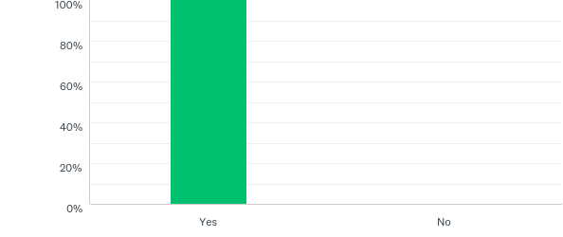
Q1: Do you live or work in the village of Hastings-on-Hudson?
Answered: 202 Skipped: 0

Slide 4
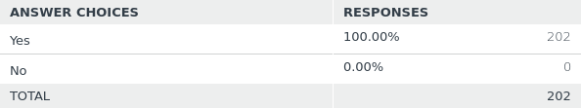
Q1: Do you live or work in the village of Hastings-on-Hudson?
Answered: 202 Skipped: 0

Slide 5
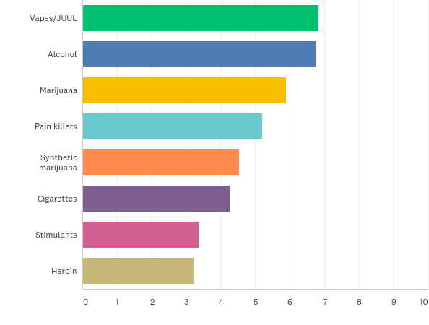
Q2: Please rank the top 3 substances that you believe are the most concerning youth substance use issues in Hastings.
Answered: 197 Skipped: 5

Slide 6
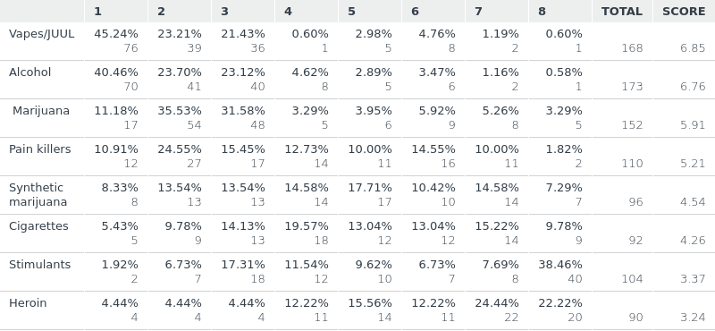
Q2: Please rank the top 3 substances that you believe are the most concerning youth substance use issues in Hastings.
Answered: 197 Skipped: 5

Slide 7
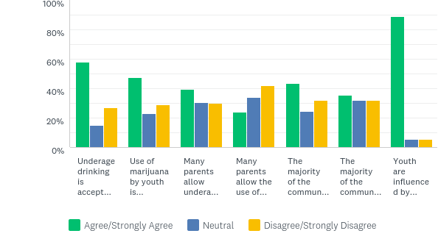
Q3: To what extent do you agree or disagree with the following statements about youth substance use in Hastings.
Answered: 198 Skipped: 4
Underage drinking is accepted
Youth
use of marijuana is accepted
Parents allow underage drinking in their homes
Parents allow marijuana use in their homes
Police should enforce underage drinking regulations.
Police should enforce marijuana regulations.
Youth are influenced by their parents drug & alcohol beliefs

Slide 8
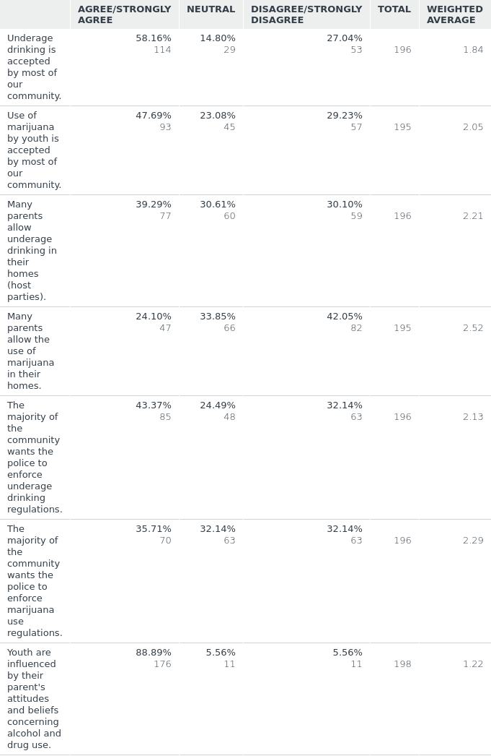
Q3: To what extent do you agree or disagree with the following statements about youth substance use in Hastings.
Answered: 198 Skipped: 4

Slide 9
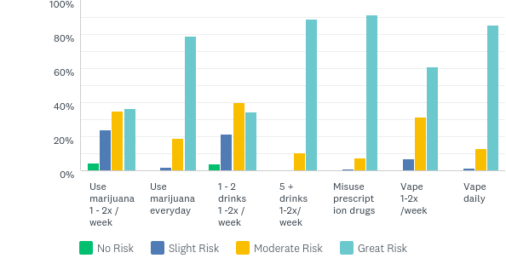
Q4: How much do you think youth risk harming their physical or mental health if they:
Answered: 199 Skipped: 3

Slide 10
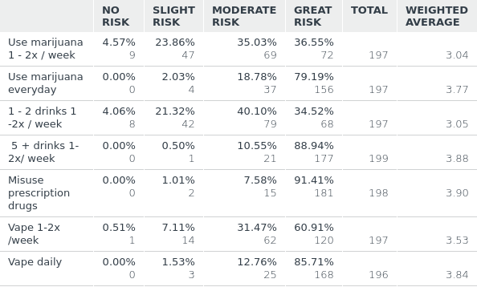
Q4: How much do you think youth risk harming their physical or mental health if they:
Answered: 199 Skipped: 3

Slide 11
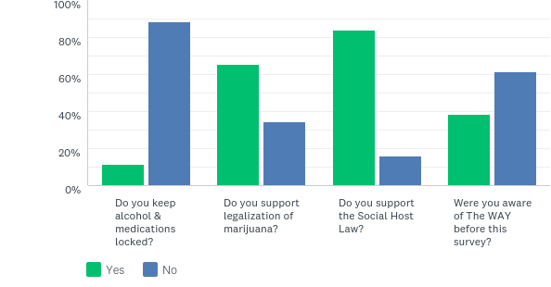
Q5: Please answer yes or no to following questions.
Answered: 201 Skipped: 1

Slide 12
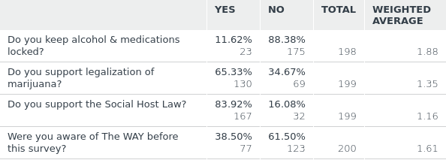
Q5: Please answer yes or no to following questions.
Answered: 201 Skipped: 1

Slide 13
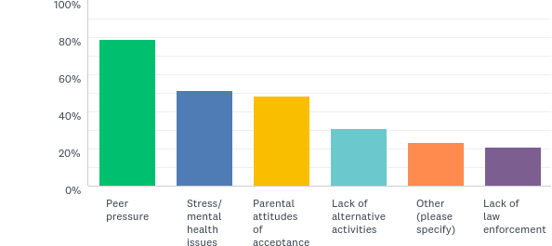
Q6: Why do you think some youth in our community choose to drink and/or use drugs? (Please check your top 3 choices.)
Answered: 202 Skipped: 0

Slide 14
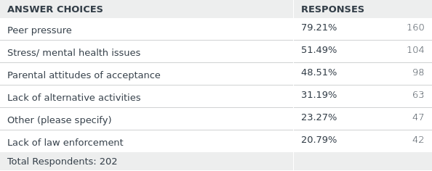
Q6: Why do you think some youth in our community choose to drink and/or use drugs? (Please check your top 3 choices.)
Answered: 202 Skipped: 0

Slide 15
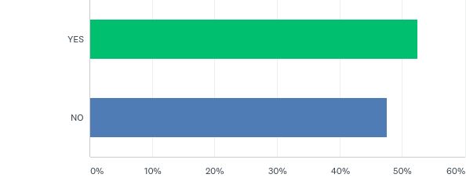
Q7: Are you the adult parent/guardian of a child currently in grades 6 to 12?
Answered: 202 Skipped: 0

Slide 16
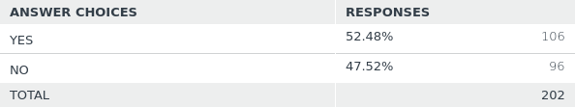
Q7: Are you the adult parent/guardian of a child currently in grades 6 to 12?
Answered: 202 Skipped: 0

Slide 17
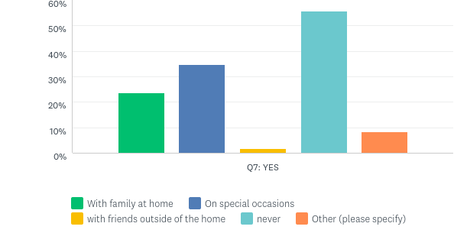
Q8: Under what circumstances would you allow your teen to drink alcohol (more then a sip or taste)? (please check all that apply)
Answered: 106 Skipped: 0
With family
at home
On special occasions
With friends outside of the home
Never
Other

Slide 18
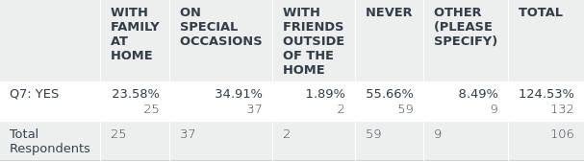
Q8: Under what circumstances would you allow your teen to drink alcohol (more then a sip or taste)? (please check all that apply)
Answered: 106 Skipped: 0

Slide 19
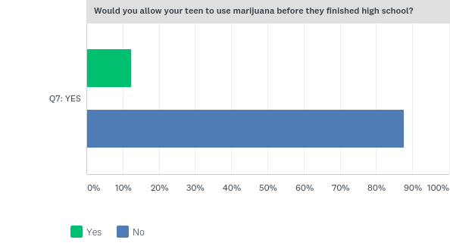
Q9: Please answer yes or no to following questions.
Answered: 105 Skipped: 1

Slide 20
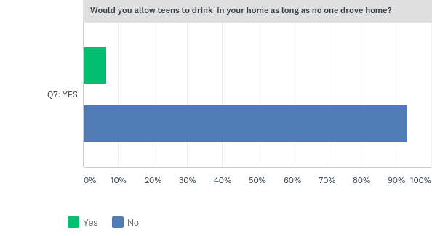
Q9: Please answer yes or no to following questions.
Answered: 105 Skipped: 1

Slide 21
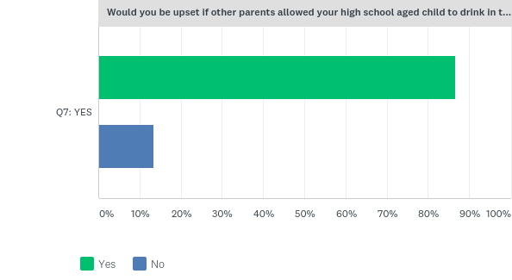
Q9: Please answer yes or no to following questions.
Answered: 105 Skipped: 1
Would you be upset if other parents allowed your high school aged child to drink in their home

Slide 22
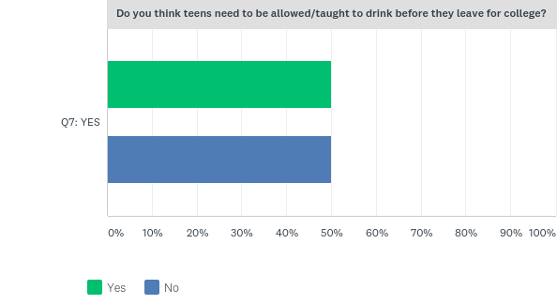
Q9: Please answer yes or no to following questions.
Answered: 105 Skipped: 1

Slide 23
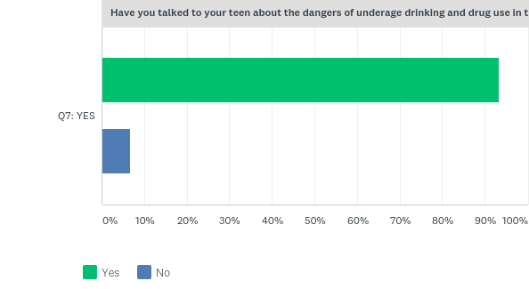
Q9: Please answer yes or no to following questions.
Answered: 105 Skipped: 1
Have you talked to your teen about the dangers of underage drinking and drug use in the past year?

Slide 24
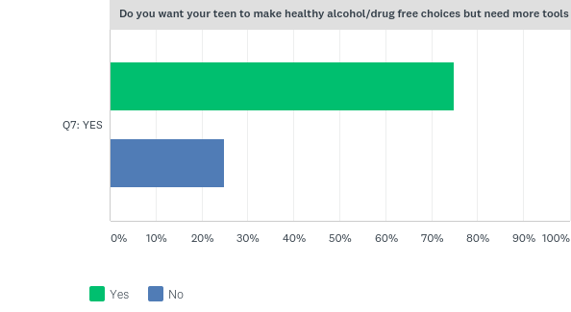
Q9: Please answer yes or no to following questions.
Answered: 105 Skipped: 1

Slide 25
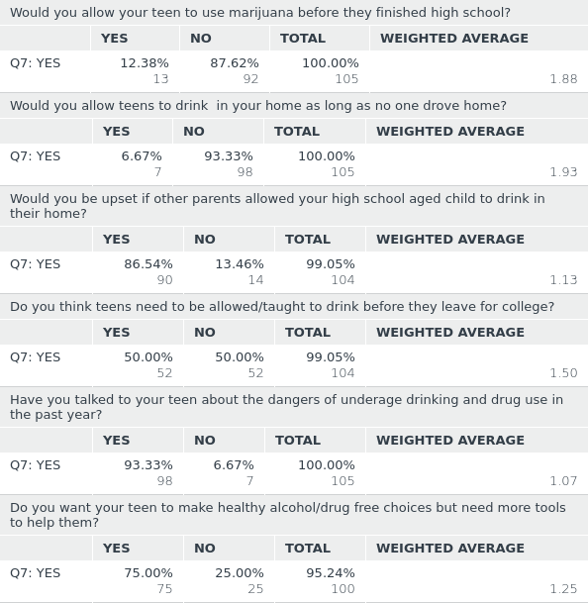
Q9: Please answer yes or no to following questions.
Answered: 105 Skipped: 1

Slide 26
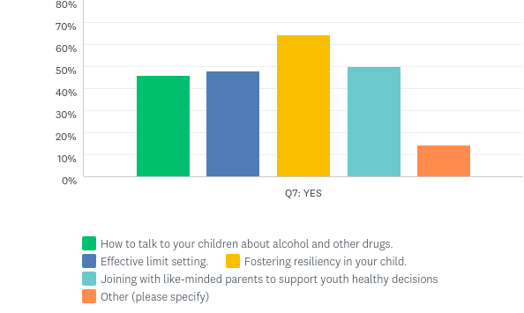
Q10: As the adult parent/guardian of middle and/or high school aged children, which of the following would you be interested in learning more about. (check all that apply)
Answered: 96 Skipped: 10

Slide 27
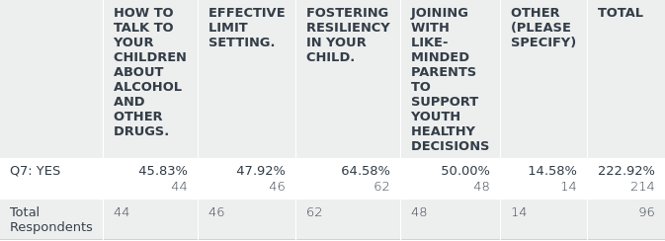
Q10: As the adult parent/guardian of middle and/or high school aged children, which of the following would you be interested in learning more about. (check all that apply)
Answered: 96 Skipped: 10

